Slide 1

Designing the Rule Engine Core
From Logic to Engine: Modularizing Underwriting Rules
Presented by: Treveshan Naidoo
TTD Consulting Internal Learning Series
Notes:
Slide Notes: Welcome back to Week 2 of our internal learning series. Today we begin building a basic rule engine framework in code, starting with the structure of individual rules. We'll keep it simple, modular, and extensible.

Slide 2
Welcome
Quick recap of Week 1
This week: How to structure code to support flexible, testable rules
Goal: Start building our own rule engine foundation
Notes:
Slide Notes: Remind the group of last week’s takeaway: we created a rule matrix and discussed the benefits of rule engines. Today, we're going to take that logic and start coding it. Focus will be on making rule classes that are easy to reuse and test.

Slide 3
Rule Structure
Every rule has:
Condition (what needs to be true?)
Result (what happens if true?)
This forms the building block of any rule engine
Notes:
Slide Notes: Clarify that each rule is basically a mini decision. If condition X is true, then do Y. All rule engines follow this basic pattern. What we're doing now is creating the foundation to formalize this logic in code.

Slide 4
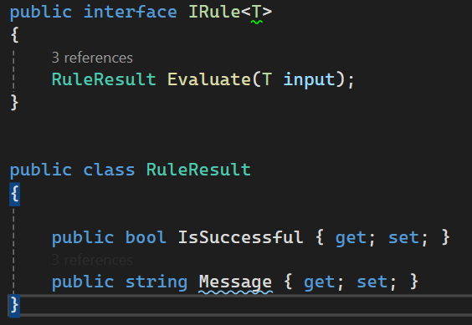
C# Interface for Rules
Generic interface allows reuse for different rule types
Notes:
Slide Notes: This is the core interface for all rules. The generic type makes it flexible so we can plug in underwriting input or other models. Each rule will return a simple result: pass or fail, with an optional message.

Slide 5
Design Patterns
Strategy Pattern: Encapsulate different rules behind the same interface
Specification Pattern: Combine rules using logical AND/OR/NOT
These patterns help with composition and reusability
Notes:
Slide Notes: Mention that Strategy is being used here—we're encapsulating interchangeable rules. Specification is more advanced but relevant for combining multiple rules into complex logic. We'll explore combining next week.

Slide 6
Rule Sources
Where can rules come from?
Hardcoded classes
Config files (JSON/YAML/XML)
Databases
Excel or Google Sheets (via adapter)
The engine stays the same, just the source changes
Notes:
Slide Notes: Stress that our design makes it easy to swap rule sources. Today we’re using code to define rules, but we’re setting up for external sources like JSON or Excel in future. This separation is key for flexibility.

Slide 7
Exercise Overview Goal: Build your first simple rule classes
Step 1: Define an UnderwritingInput class
Step 2: Create rule classes:
AgeUnder25Rule
SmokerRule
Step 3: Each should implement IRule<UnderwritingInput>
Step 4: Write a console app or unit test to run them
Notes:
Slide Notes: Guide everyone through the goal of the session. You’re building basic rule logic in code that aligns with what we did in our Excel rule matrix. Use your own data if you like. Encourage peer collaboration.

Slide 8
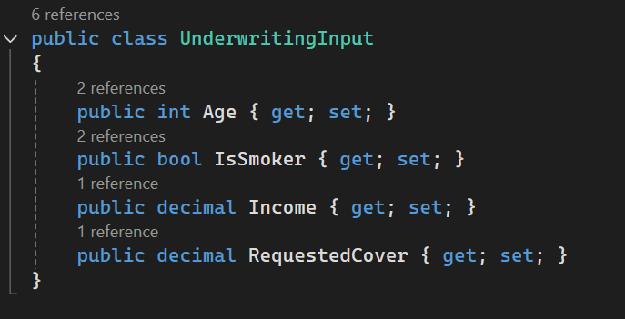
Example Input Model
Notes:
Slide Notes: This is our input class for this session. It matches the columns in our underwriting rule matrix. You can add to it later, but keep it simple for now. Every rule we write will consume this input.

Slide 9
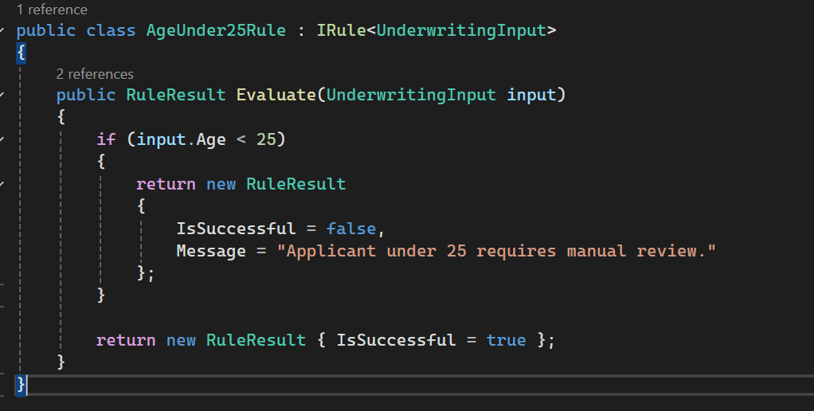
Sample Rule Class
Notes:
Slide Notes: Explain that this rule checks for a specific underwriting condition. If the person is under 25, it fails. If not, it passes. Other rules will look very similar but check different fields. Once this works, testing it is easy.

Slide 10
Outcome of This Week
We now have:
A reusable rule structure
Rules that are independent and testable
The foundation for plugging in multiple sources
Next week: Combining rules and building a simple rule runner
Notes:
Slide Notes: Highlight the progress made: we’ve moved from ideas to working code. These rules can now be composed, tested, and reused. Next week, we go further by chaining and evaluating multiple rules at once.

Slide 11
Thank You
Great job building your first rule engine components
Bring your code to the next session
Optional: Try writing a third rule of your own
Notes:
Slide Notes: Congratulate the group. Invite them to share their rules on Slack or GitHub. Suggest they try writing a "cover vs income" rule to prepare for combining logic next week.

